Slide 1
Set operations

Slide 2

Set Union
Set Union
The union of sets A and B (denoted by A ∪ B) is the set of elements that are in A, in B, or in both A and B. Hence, A ∪ B = { x | x ∈ A OR x ∈ B }.
Example − If A = { 10, 11, 12, 13 } and B = { 13, 14, 15 }, then A ∪ B = { 10, 11, 12, 13, 14, 15 }. (The common element occurs only once)

Slide 3
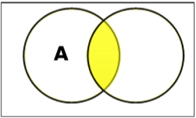
Set Intersection
The intersection of sets A and B (denoted by A ∩ B) is the set of elements which are in both A and B. Hence, A ∩ B = { x | x ∈ A AND x ∈ B }.
Example − If A = { 11, 12, 13 } and B = { 13, 14, 15 }, then A ∩ B = { 13 }.

Slide 4
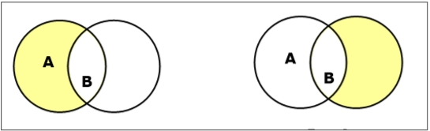
Set Difference
The set difference of sets A and B (denoted by A – B) is the set of elements that are only in A but not in B. Hence, A - B = { x | x ∈ A AND x ∉ B }.
Example − If A = { 10, 11, 12, 13 } and B = { 13, 14, 15 }, then (A - B) = { 10, 11, 12 } and (B - A) = { 14, 15 }. Here, we can see (A - B) ≠ (B - A)

Slide 5
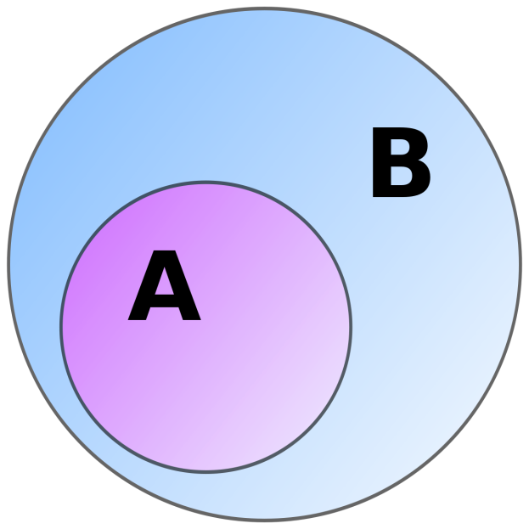
Set Difference
In mathematics, a set A is a subset of a set B if all elements of A are also elements of B; B is then a superset of A.

